Slide 1
Crime, Custodial Deaths and Justice Statistics In India
By : KSHITIJ BHAT

Slide 2
Contents
Purpose of the project
Tools and packages used
Data Source and Cleansing of Raw Data
What is Custodial Death
What is IPC and SLL
Data Analysis: (For the Years: 2008 – 2013)
Custodial Deaths:
Justice Statistics:
Observations
Conclusion

Slide 3
Purpose:
To extract the custodial deaths and disposal of cases by courts related data from National Crime Records Bureau of India website for the years 2008 to 2013.
Analyze the Custodial Deaths by visualizing the below statistics:
Custodial Death VS Policemen Charge-sheeted each year in India
Custodial deaths divided into the states
Analyze the disposal of cases by courts for IPC and SLL crimes by :
Visualizing the performance of Indian courts by comparing the Number of persons under trial to No of trials completed
Checking which states have high number of convictions under SLL and IPC
Comparison of percentage of cases pending for each year for the top 5 ranked states in number of convictions
Comparison of number of cases compounded or withdrawn for each year for the top 5 states

Slide 4
Tools and packages used:
Programming Language: Python 3.0
Python packages: matplotlib , numpy , pandas, os, statistics, bokeh, seaborn, datetime, glob, requests, itertools, tabula
Platform: Jupyter Notebook ( Anaconda Navigator)
Screen Recording: Screen recorder by SCREENCAST MATIC (https://screencast-o-matic.com/screen-recorder)

Slide 5
Data source: http://ncrb.gov.in
Raw file: Source_Links.xls
Raw Data Description:
The source file is an excel file containing a dataframe with columns as the category of data, and rows as the website addresses of the crime data files to be downloaded
Data considered for analysis:
Crime data of India for the recent 6 years ( 2008 -2013)

Slide 6
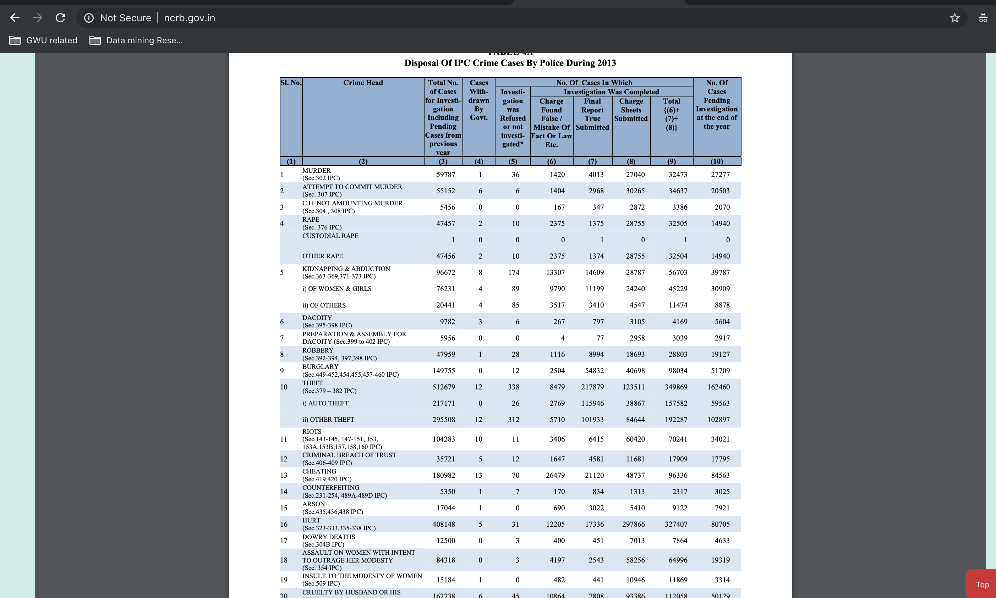
Quick look of raw data over internet:

Slide 7
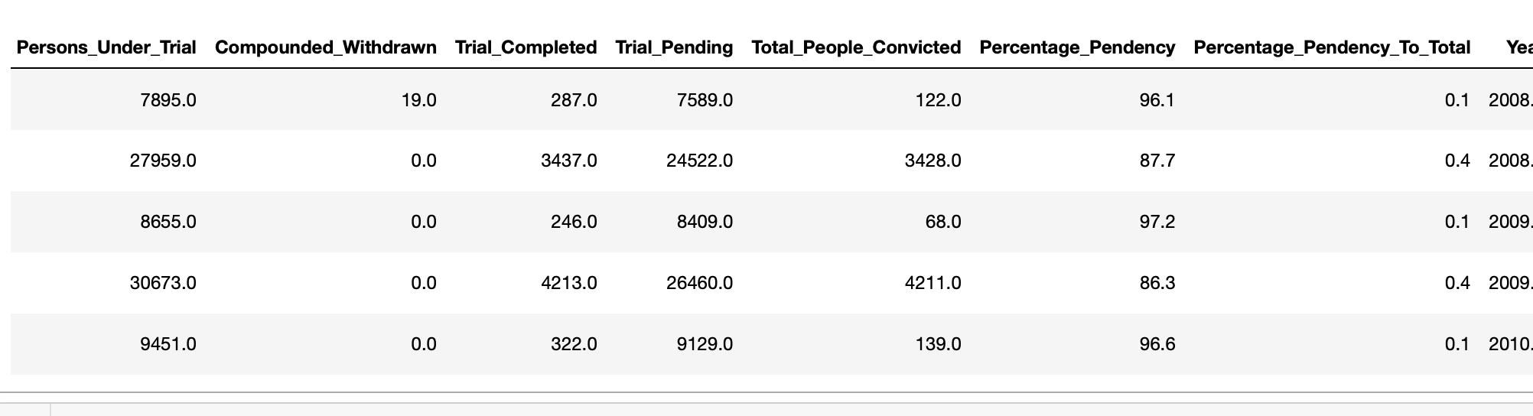
After the download and cleansing:

Slide 8
Custodial Death:
Death of a person, to be precise a person accused of some crime while under the custody of police
Custodial Deaths are of two types:
1. Custodial death of person being remanded by court to police
2. Custodial death of person not being remanded by court to police
Indian Penal Code(IPC):
The main criminal code of India. It is a comprehensive code intended to cover all substantive aspects of criminal law
Special & Local Laws(SLL):
Laws belonging to particular region, group, or related to some regulatory Acts established by the government

Slide 9
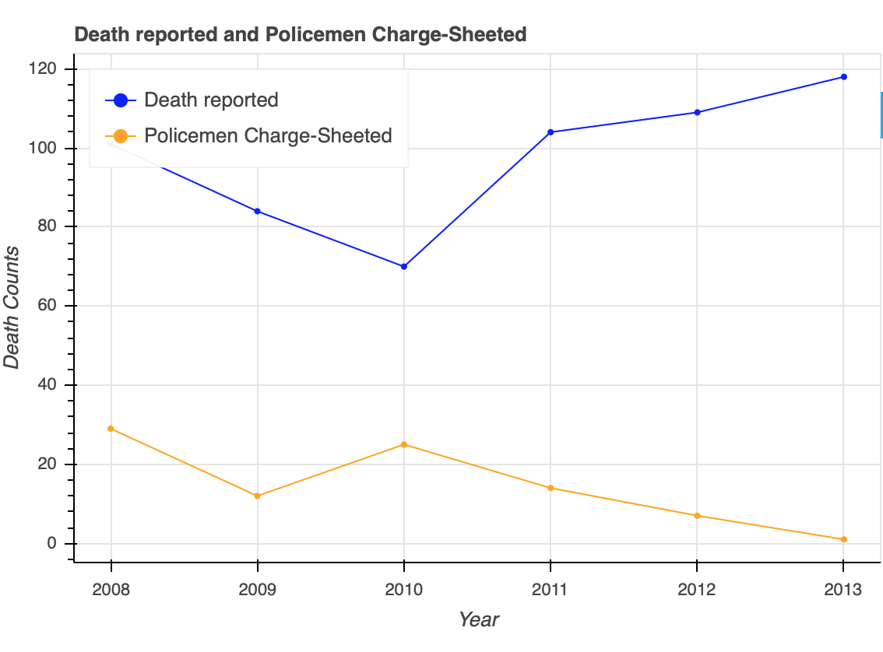
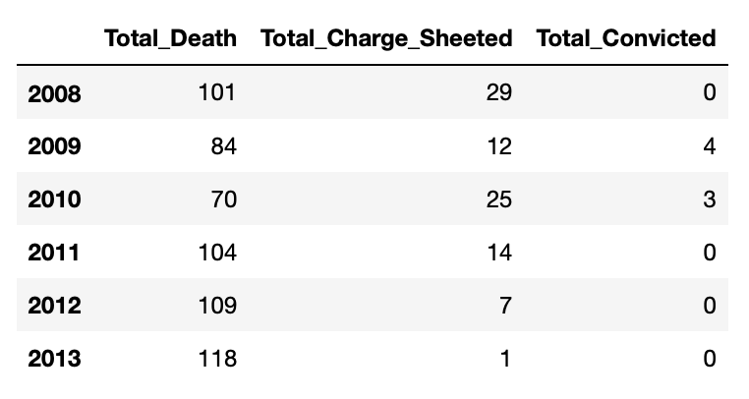
Custodial Death Reported VS Police Charge-sheeted

Slide 10
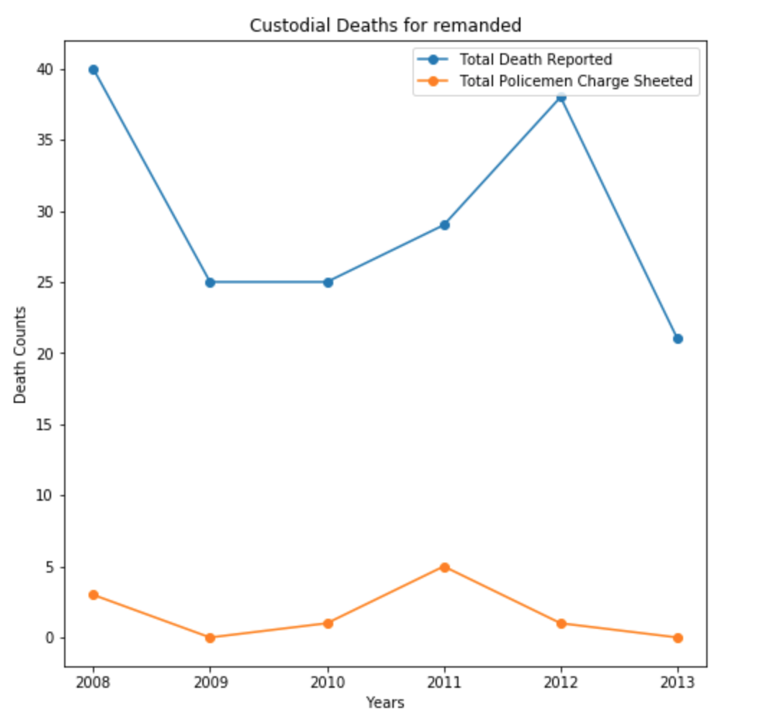
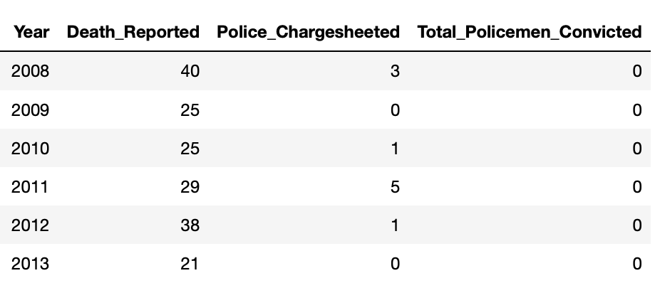
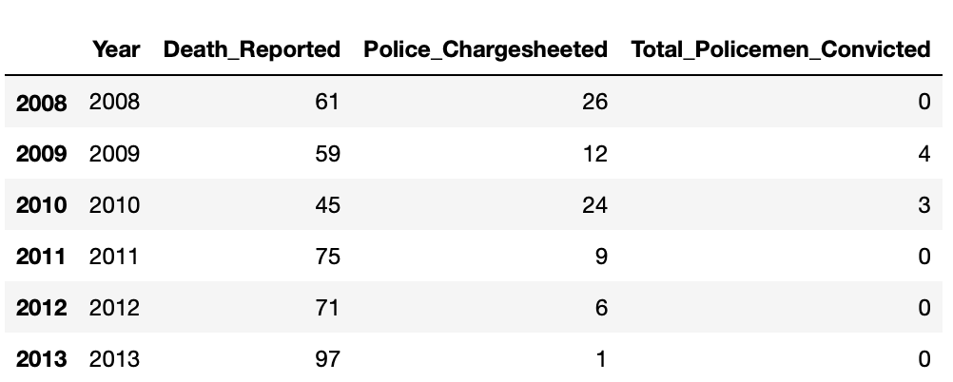
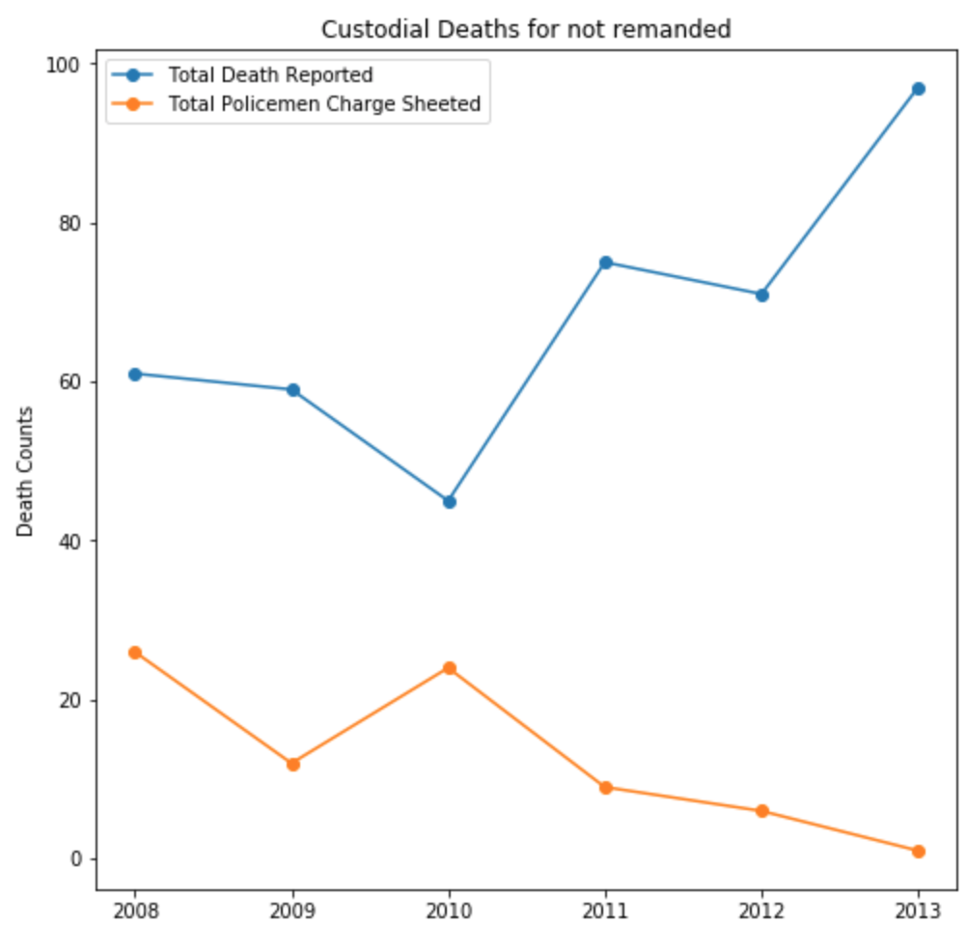
Custodial Death Remanded
Custodial Death Not Remanded

Slide 11
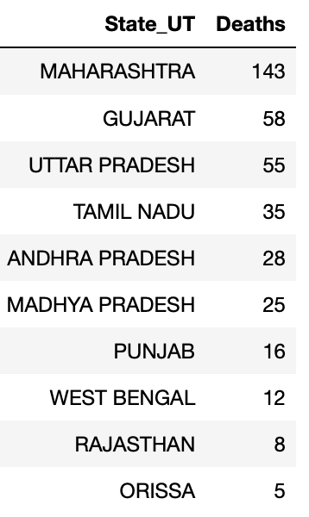
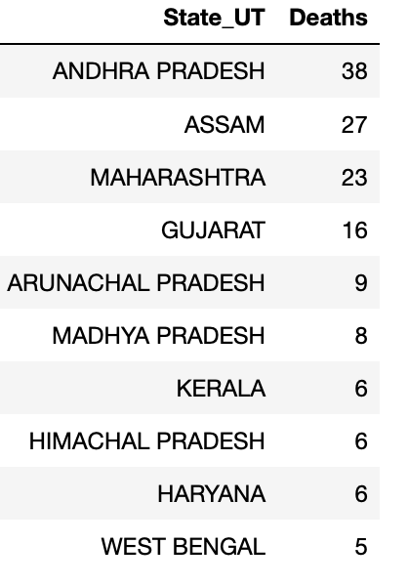
Which States have high number of custodial deaths?
Contribution of each state
Not Remanded
Remanded

Slide 12
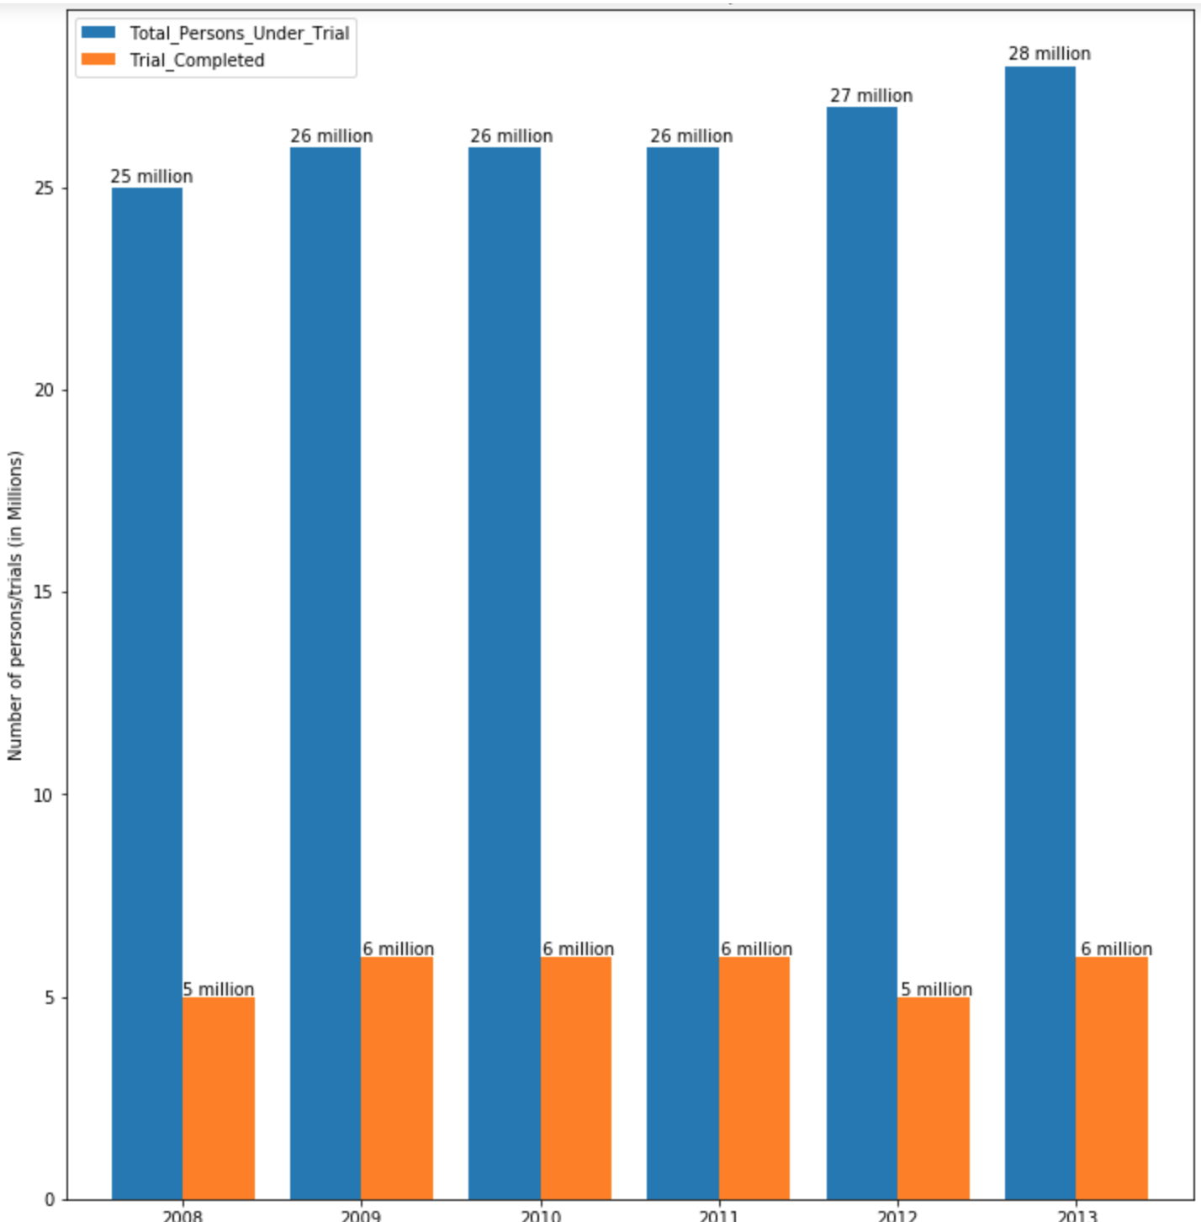
Total persons under trial Vs Total trial completed

Slide 13
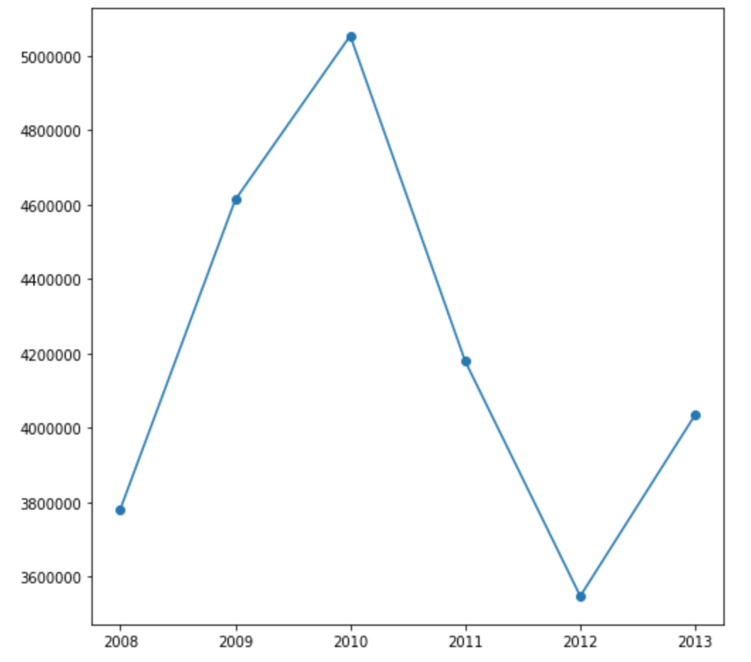
How many are being convicted by courts over the years?

Slide 14
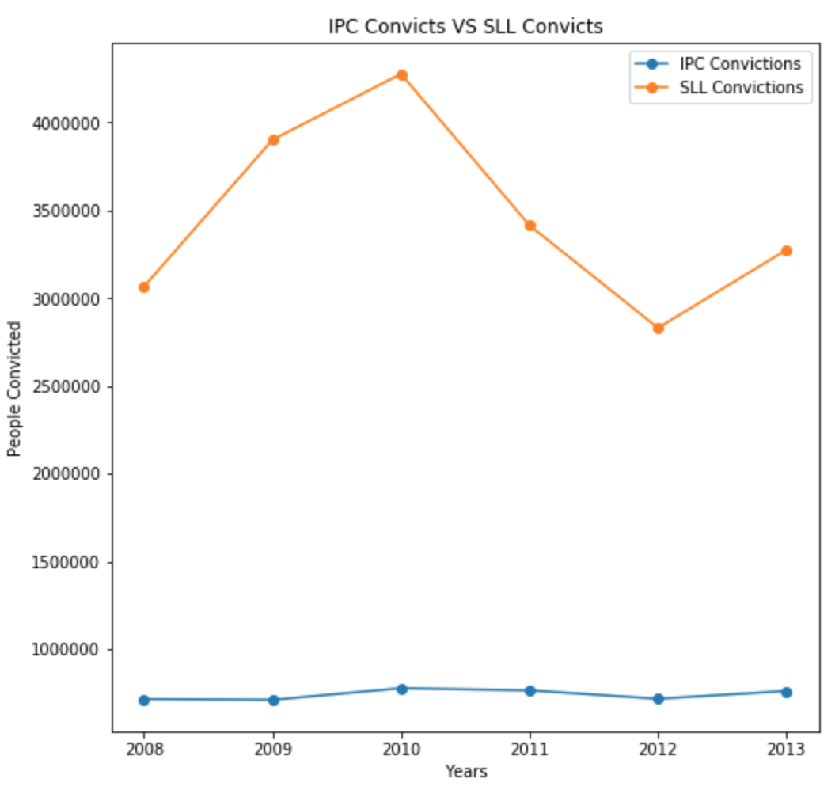
Convictions under SLL vs Convictions under IPC

Slide 15
IPC Convictions for the year 2010:

Slide 16
SLL Convictions for the year 2010

Slide 17
IPC/SLL Convictions 2008-2013

Slide 18
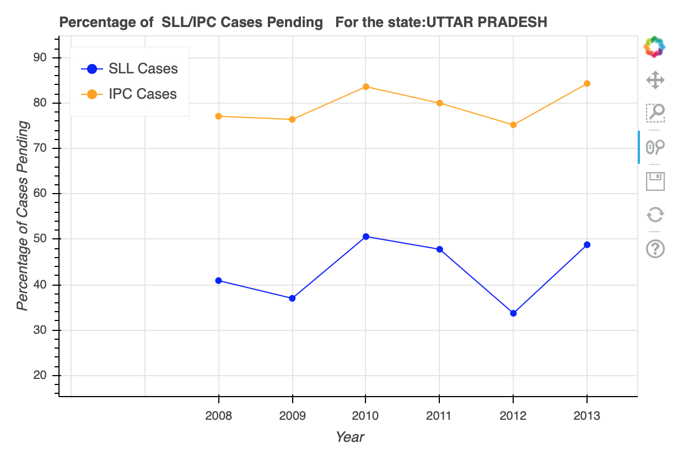
Top 5
State with highest number of convictions: UTTAR PRADESH
Top 5 States:
UTTAR PRADESH
MADHYA PRADESH
TAMIL NADU
KERALA
RAJASTHAN

Slide 19
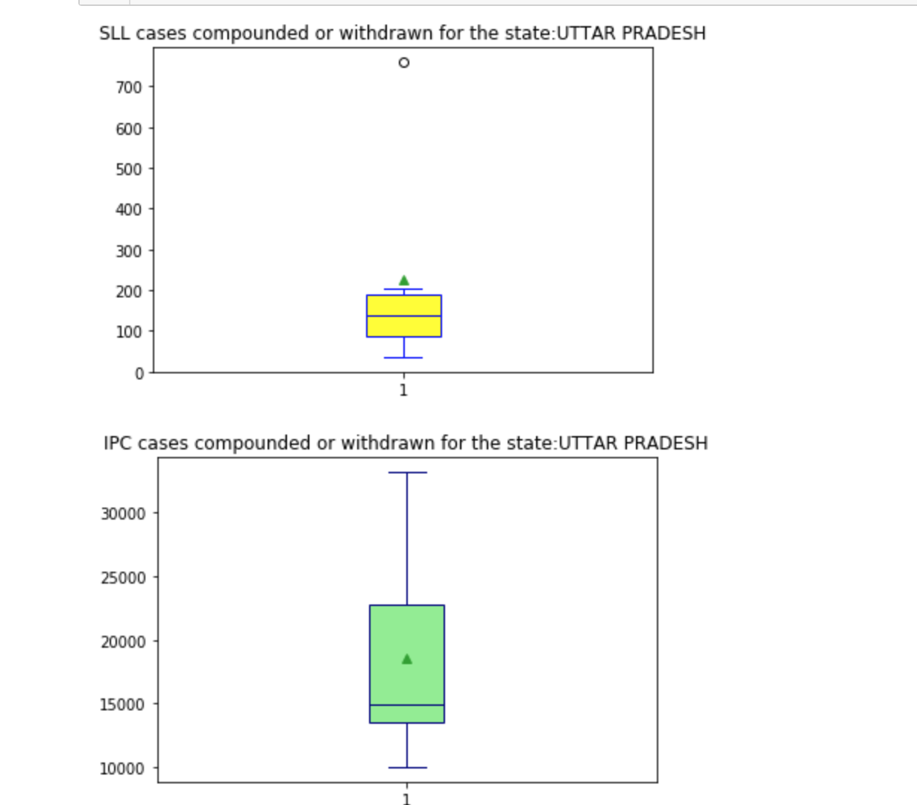
Cases Compounded or Withdrawn
UTTAR PRADESH
Top 5 states

Slide 20
Observations: Over the span of 6 years(2008-2013)
Custodial Deaths:
For the period of six years, Total 586 custodial deaths were reported, but the total number of Police men convicted is only 7, related to only 2 reported cases deaths.
The study also discovered that there are states or union territories which have no custodial deaths over the years
Disposal of Cases by courts:
Every year, several thousands of IPC and SLL cases are left incomplete, causing delay in the delivery of justice.
2. The regional population also plays a factor, hence the states like Uttar Pradesh, Maharashtra have high rate of crimes resulting in more number of cases and trials.

Slide 21
Conclusion
The thorough investigation of the Police officials charge sheeted is necessary for the maintenance of law and order even among the law enforcement officials
As the number of crimes occurring each year goes on supplementing to the number of cases or number of persons under trial, the states with high crime rates (Uttar Pradesh, Rajasthan, Tamil Nadu, Kerala, Madhya Pradesh, Maharashtra) display the great need law officials and law infrastructures.

Slide 22
Thank you

